Slide 2
Министерство энергетики Республики Казахстан
Prospects for achieving INDC
in the Republic of Kazakhstan
Minister of Energy Bozumbayev K.A.
1

Slide 3
25-26 May 2016, Astana The IX Astana Economic Forum "New economic reality: diversification, innovation and knowledge economy"
«Today, in the pursuit of economic gain, we are missing the complex environmental issues. A global initiative to combat climate change is very important, but we must not forget about other problems».
N.A. Nazarbaev

Slide 4
Measures for improving policy in the field of climate change
Kazakhstan INDC: 15% (unconditional target) and 25% (conditional target ) by 2030 from the 1990 level; Law of the Republic of Kazakhstan dated April 8, 2016 № 491-V 3RK "On amendments and additions in certain legislative acts of the Republic of Kazakhstan on ecology issues”; Law of the Republic of Kazakhstan dated April 28, 2016 № 506-V 3PK "On amendments and additions to some legislative acts of Kazakhstan on the transition of the Republic of Kazakhstan to the "green" economy"; The authorities of governmental bodies responsible for climate policy (ME) implementation and energy saving (MID) were strengthened; Draft Decree of the President of the Republic of Kazakhstan on the signing of the Paris Agreement was prepared
Notes:
В 2016 году в Казахстане будут заключены 10 энергосервисных договоров по проектам энергосбережения и повышения энергоэффективности. Консолидированный объем внешних грантов и займов международных финансовых учреждений в проекты повышения энергоэффективности в период с 2012 по 2019 год составит около 100 миллионов долларов США. А в 2017 году будет создан Фонд энергоэффективности на площадке МФЦ «Астана»

Slide 5
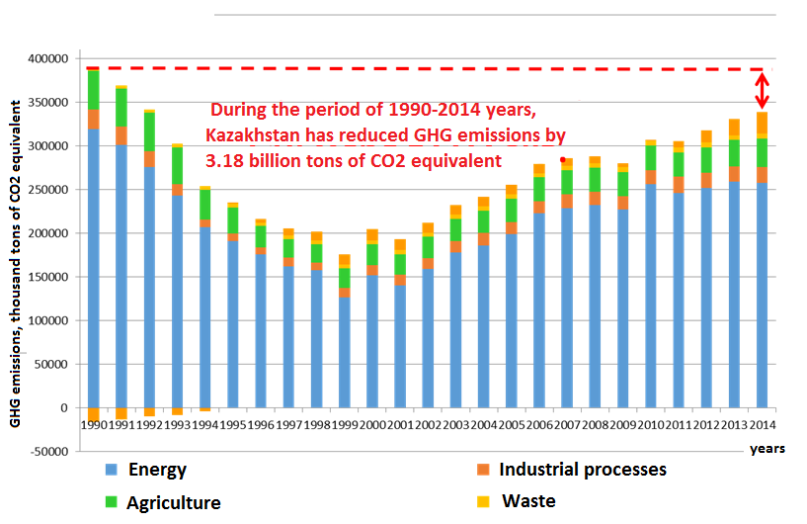
The dynamics of GHG emissions, actual data (considering forests and agriculture)
Source: National GHG inventory in Kazakhstan, a report to the UNFCCC 2016
4

Slide 6
The impact of climate policies on GDP growth
Тhe difference between the real GDP from an baseline scenario in % of the absolute value of INDC and ETS Scenarios
Measures for GHG reduction lead to higher rates of GDP growth until 2033

Slide 7
The potential for low-carbon development in Kazakhstan
1
2
3
Increasing Production Efficiency
Renewable energy
Increasing the carbon intensity of forests and pastures
The specific energy consumption of Kazakhstan's GDP at constant prices is 6.7 times higher than the average for OECD countries, 8 times higher than energy intensity of the EU's GDP, 1.2 times higher than in Russia and 1.5 times higher than in Belarus
• Wind - more than 900 billion kWh /year
• Solar - up to 37 billion kWh /year
• Hydro - 62 billion kWh /year
4
The development of an emissions trading system

Slide 8
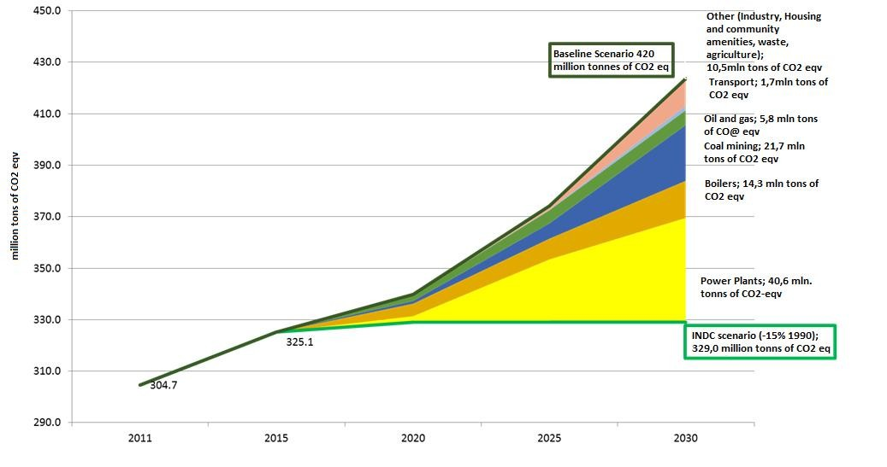
Potential for GHG emissions reduction by sectors and INDC implementation

Slide 9
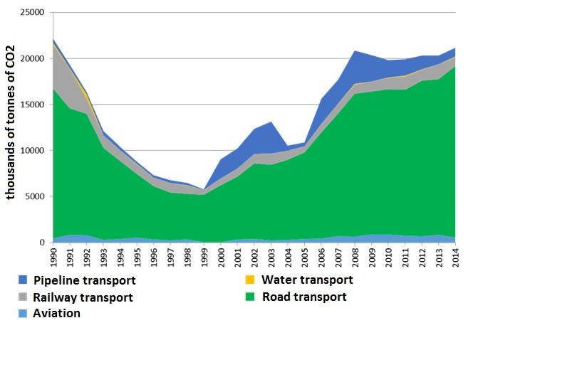
Greenhouse gas emissions in the transport sector
According to the national inventory report of anthropogenic emissions for 1990-2014 years

Slide 10
The share of renewables in energy consumption of the Republic of Kazakhstan,%
According to the Ministry of National Economy Committee on Statistics

Slide 11
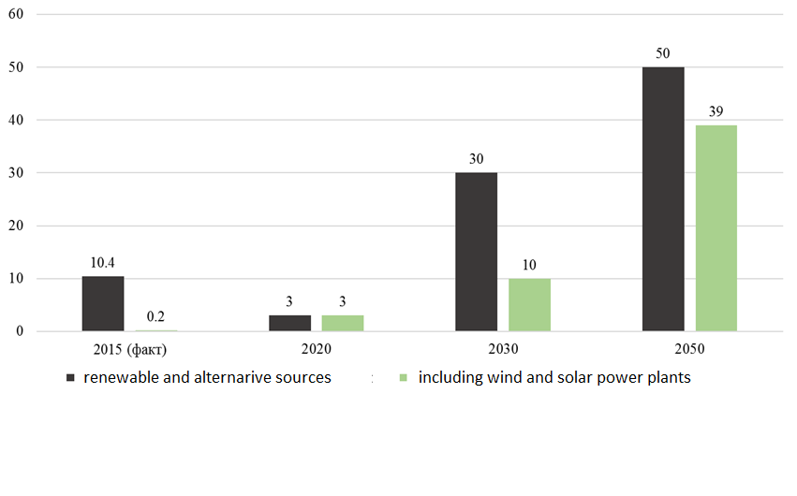
Forecast for renewable & alternative sources development in production of electricity until 2050 in the Republic of Kazakhstan,%
According to KEGOC

Slide 12
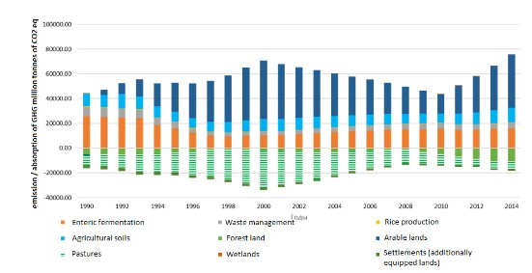
The dynamics of emissions and GHG absorption in agriculture

Slide 13
Emissions Trading System
Stage | Number of deals | Amount of realized quotas (units) | Number of companies | The average price per ton of quota | The total amount of trading (KZT)
2014 | 34 | 1 252 950 | 20 | 301 KZT | 175 476 786
2015 | 40 | 1 983 922 | 37 | 607 KZT | 754 635 670
Results
Acquiring the experience by Kazakh enterprises in monitoring,
reporting and emissions trading;
There is a necessity of improving approaches of quotas
distribution and carbon units trading

Slide 14
The strategic goals of the Republic of Kazakhstan
- The goal is achieved - The goal is not reached

Slide 15
The ways of INDC achievement in Kazakhstan
With Paris Agreement ratification Kazakhstan has to adopt a complex measures for low- carbon development
The development of Road map on transition to low-carbon development
Increasing energy efficiency of national economy sectors
• Generation of electricity and heat
• Mining and manufacturing industries
• Agriculture
• Constructing
• Transport and other sectors of the economy
Renewable Energy Development
ETS development

Slide 16
Thank you for attention! www.energo.gov.kz

